Slide 1

SafeGuardian AI: Agentic Women Safety and Intelligent SOS Response Platform
SOA Project Review-2
Thursday, September 23rd, 2026
 | Under the Guidance of Dr. Srikanth Cherukuvada Assistant Professor, Department of Computer Science and Engineering, KLH CSE Bowrampet Campus
Team Members B Akhil Varma - 2420030141 K. Vamsidhar - 2420030341 K.V.S. Jaswanth - 2420030467

Slide 2
Outline of Research Work
Focus
Introduction
Literature Survey
Challenges
Research Objectives
Conclusion & Future Work
References
Publications Details

Slide 3
Problem Statement
Women’s safety remains a major concern in today’s world, particularly during situations involving harassment, stalking, unsafe surroundings, or emergencies. Existing safety applications mainly depend on manual SOS activation, basic location sharing, and predefined emergency contacts, which may not be sufficient when a user is unable to interact with the phone or when the surrounding risk needs to be assessed. There is a need for an intelligent safety platform that can combine rapid SOS activation, real-time location monitoring, AI-based threat detection, risk assessment, and coordinated emergency response to provide faster and more context-aware assistance.

Slide 4
Objectives
To make this application:
1. Develop a secure personal safety and emergency-response system.
2. Provide user registration and authenticated login.
3. Allow users to manage trusted emergency contacts.
4. Enable one-click SOS activation during emergencies.
5. Capture and associate the user's current location with the SOS.
6. Automatically create emergency notification records.
7. Process pending notifications using a background notification worker.
8. Deliver emergency alerts to saved contacts through email.
9. Maintain SOS status, resolution and emergency history.

Slide 5
Literature Survey
Authors | Title of the Paper | Methodology | Inferences | Limitation/Future work
Harikiran et al. (2016) | Smart Security Solution for Women Based on Internet of Things (IoT) | IoT-based safety device, automatic sensing, communication with nearby people/police | Demonstrates how IoT can support automatic emergency detection and rapid assistance. | Primarily focuses on IoT/device-based safety rather than AI-driven contextual decision-making and coordinated software agents.
Eisenhut et al. (2020) | Mobile Applications Addressing Violence Against Women: A Systematic Review | Systematic review of 327 relevant applications; 171 included and categorized into emergency, avoidance, education, reporting/evidence, and support | Found that 46.78% of reviewed apps primarily provided emergency functions, showing that current solutions are heavily oriented toward one-time emergency response. | Highlights the need for further research into prevention, safety, efficacy, sustainability, and data security.
Akram et al. (2020) | Design of a Smart Safety Device for Women using IoT | IoT safety device with fingerprint verification, automatic alerting, location support, messaging and mobile application | Demonstrates integration of IoT sensing, automatic alerts, location information and communication for women's safety. | Hardware-oriented approach; does not provide a unified agentic AI architecture for threat assessment and intelligent response.
Doria et al. (2021) | Women’s Experiences of Safety Apps for Sexualized Violence: A Narrative Scoping Review | Systematic search and review of studies concerning women's experiences with safety applications | Identified important themes including security, accessibility and knowledge, showing that usability and user experience are important alongside technical features. | Further research is required to address identified gaps and improve the effectiveness and usability of safety applications.
Naaz et al. (2026) | Comprehensive Review on Women Safety Technologies: Indian Perspective | Structured review of women's safety technologies including mobile applications, GPS, IoT, wearables, surveillance and ML | Identifies existing technologies and emphasizes the importance of contextual relevance, accessibility, affordability and improved integration. | Identifies gaps in comprehensive evaluation, Indian-context research, awareness and real-world adoption.

Slide 6
Research Gap Identification
Existing emergency-response systems provide important features such as SOS activation, location sharing and emergency-contact notification, but these capabilities are often implemented as separate functions. There is a need for a lightweight and integrated system that connects authentication, emergency-contact management, location-aware SOS activation, notification queuing and automated alert delivery into a single workflow. SafeGuardian addresses this gap by combining these components with an asynchronous notification worker, allowing emergency events to be created independently from the actual notification-delivery process.

Slide 7
Innovation, Creativity, and Novelty
Integrated Emergency Workflow — combines authentication, contacts, SOS, location and notifications.
Asynchronous Notification Processing — separates SOS creation from email delivery using a background worker.
User-Specific Emergency Contacts — each user's contacts are securely associated with their account.
Location-Aware SOS — captures latitude and longitude when an emergency is triggered.
Notification Queue — pending notifications are stored before delivery.
Delivery Tracking — notification status and sent_at timestamps are maintained.
SOS Lifecycle Management — supports active, resolved and historical emergency records.
Lightweight Architecture — built using web technologies without requiring a large distributed infrastructure.

Slide 8
Feasibility and Project Plan
Technical: Uses well-established technologies such as JavaScript, Node.js, Express.js and PostgreSQL.
Operational: Simple browser-based interface makes the system easy to operate.
Financial: Uses open-source technologies and existing development tools.
Scalability: Notification processing is separated from the main application through a worker.
Maintainability: Modular backend routes, middleware, services and worker components.

Slide 9
Feasibility and Project Plan
1. Requirements & Research
Weeks 1–2
Problem analysis, requirements and literature survey
2. Architecture & Design
Weeks 2–3
Backend API and Authentication Design
3. Core Development
Weeks 3–5
Emergency-contact and SOS implementation
4. Notification Delivery
Weeks 5–7
Notification worker and email integration
6. Testing & Deployment
Weeks 10–12
Testing, debugging, Docker deployment and final demonstration
5. SOA Integration & UI
Weeks 7–10
Frontend dashboard development
Time Feasibility

Slide 10
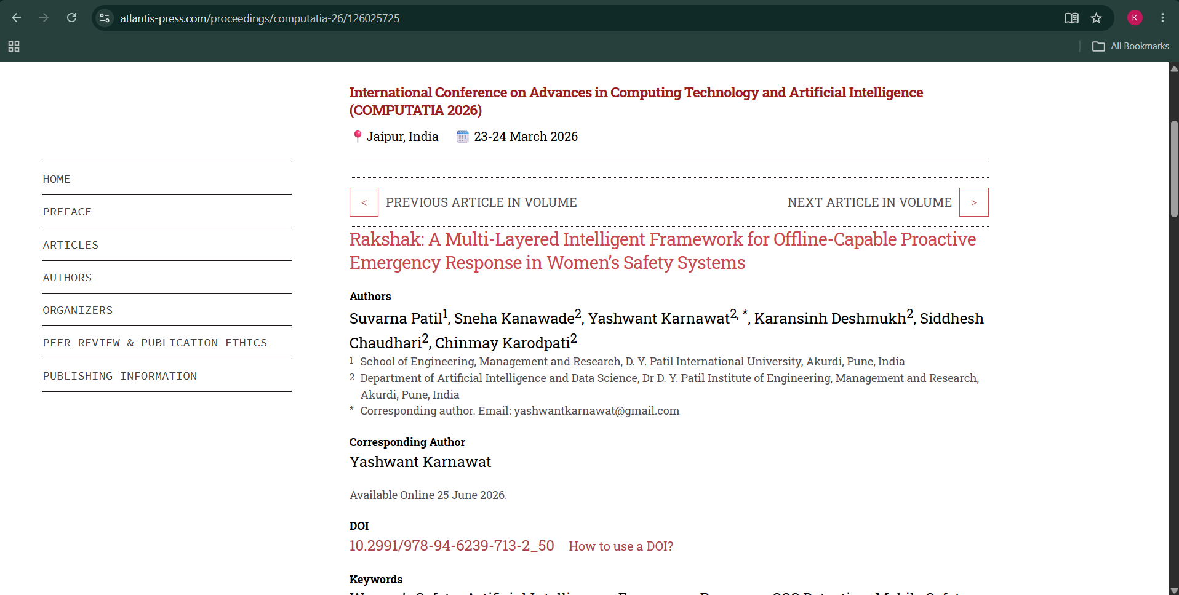
Base Paper

Slide 11
Base Paper Methodology - Rakshak
Danger Situation
Trigger Detection
Danger Detection
SOS
Location
Alert
Contacts
Rakshak uses different ways to detect an emergency, such as voice, eye-blink and tap inputs. When a danger is detected, the system activates SOS, gets the user's location and sends an alert to registered emergency contacts. It also supports emergency communication when internet connectivity is limited.

Slide 12
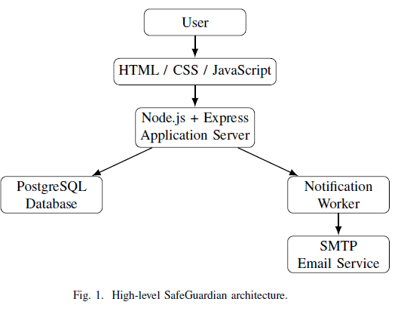
Project Design

Slide 13
Methodology Adopted from Rakshak
Studied the emergency-detection and response approach presented in Rakshak.
Adopted the core concept of initiating an emergency response when a user faces a critical situation.
Incorporated SOS activation as the primary emergency trigger.
Incorporated location acquisition as part of the emergency event.
Incorporated emergency-contact notification as the response mechanism.
Adapted the concept into a lightweight web-based implementation.
Added authenticated users and user-specific emergency contacts.
Implemented asynchronous notification processing using a dedicated worker.
Implemented email-based emergency alert delivery.
Maintained SOS status and history for tracking the emergency lifecycle.

Slide 14

Results

Slide 15
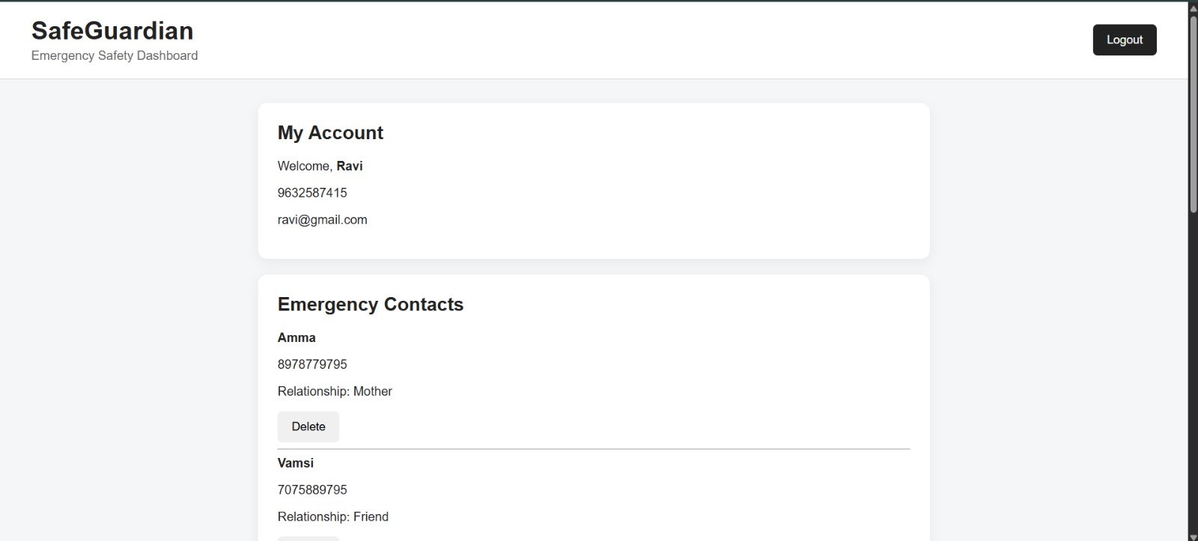
Results

Slide 16
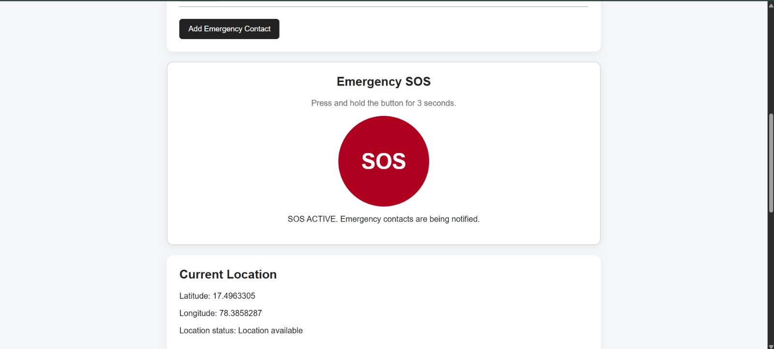
Results

Slide 17
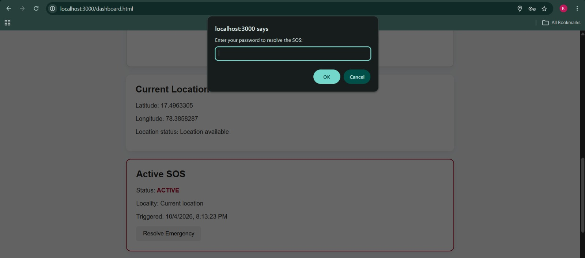
Results

Slide 18
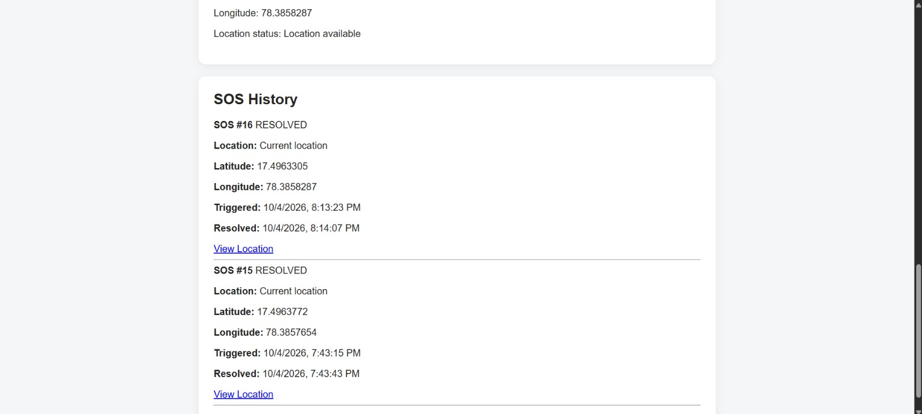
Results

Slide 19
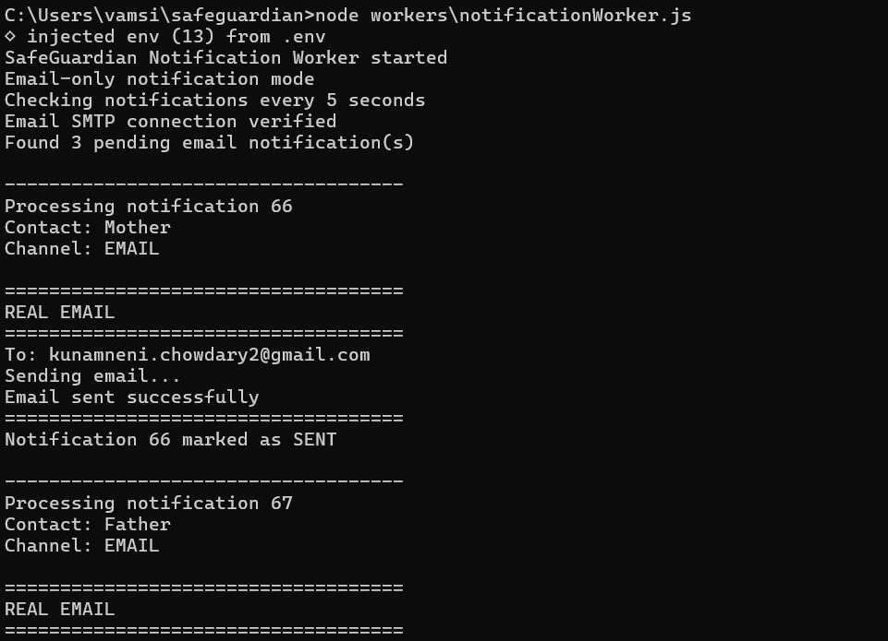
Results

Slide 20
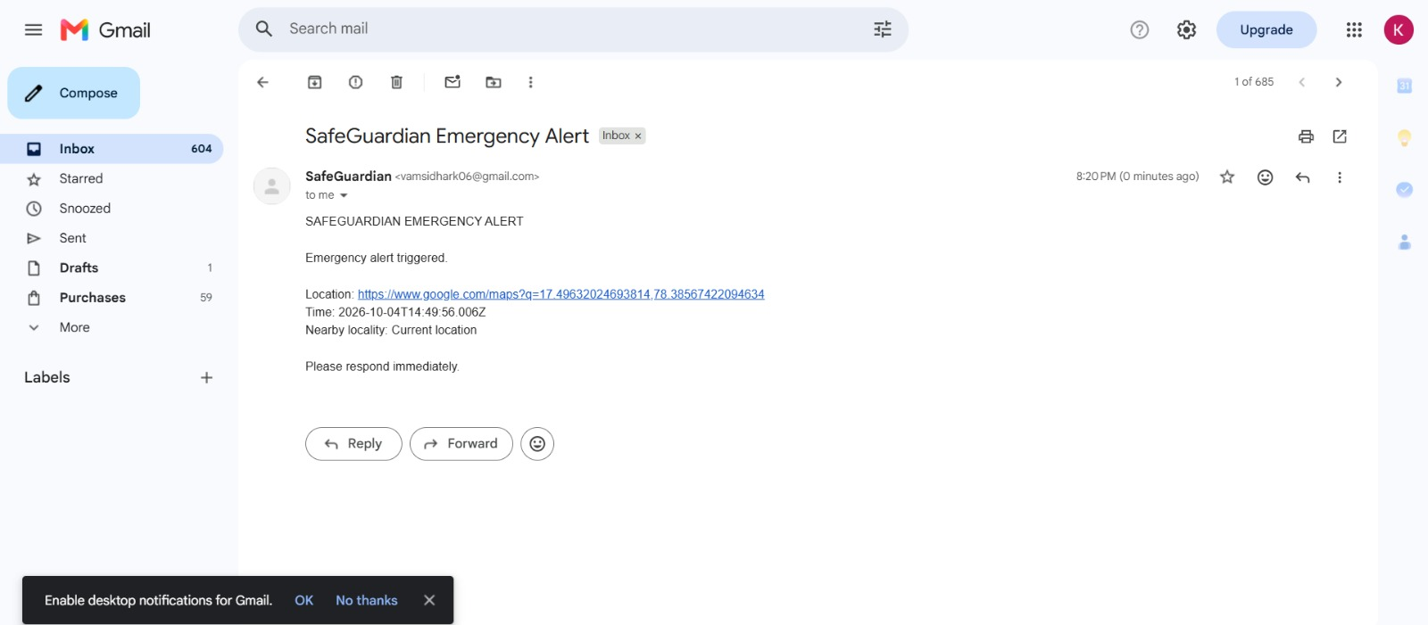
Results

